Slide 1


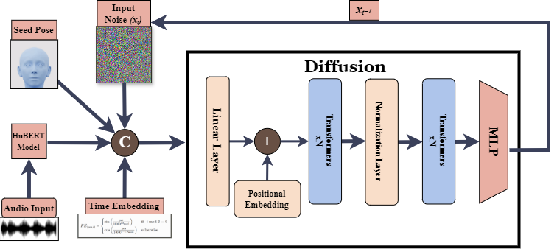
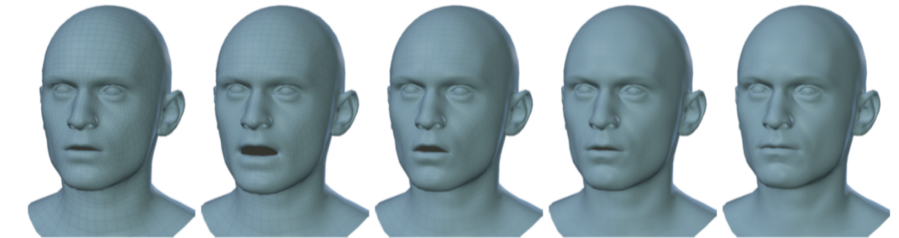
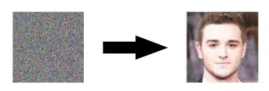
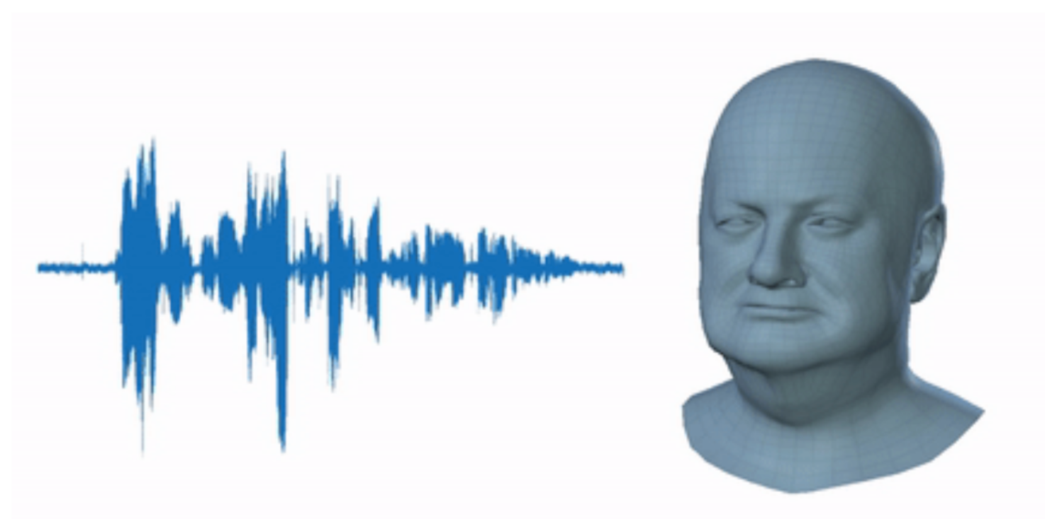

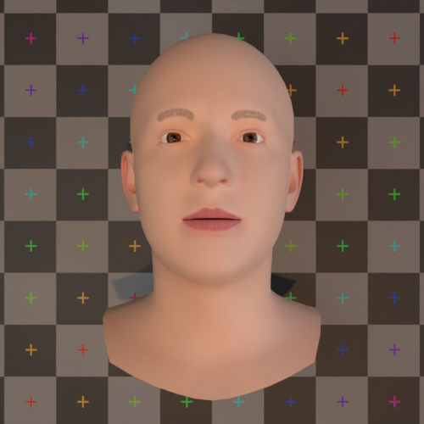
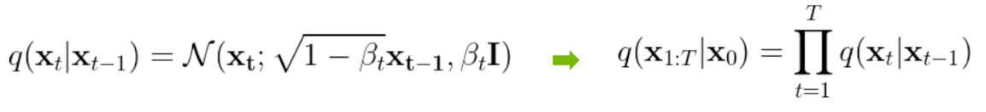
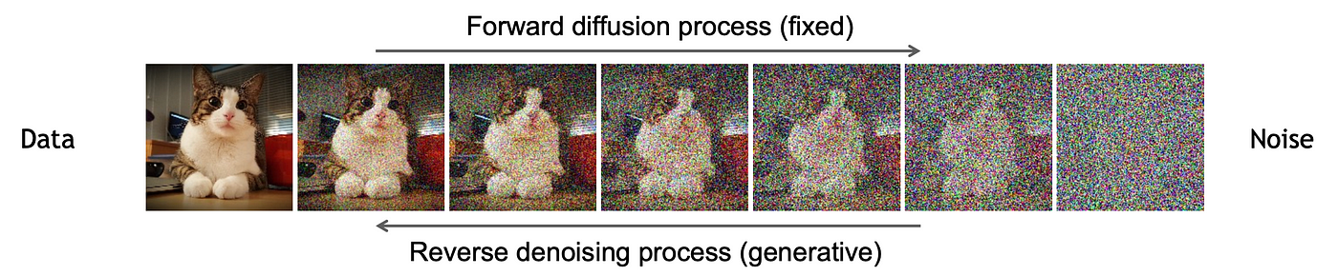
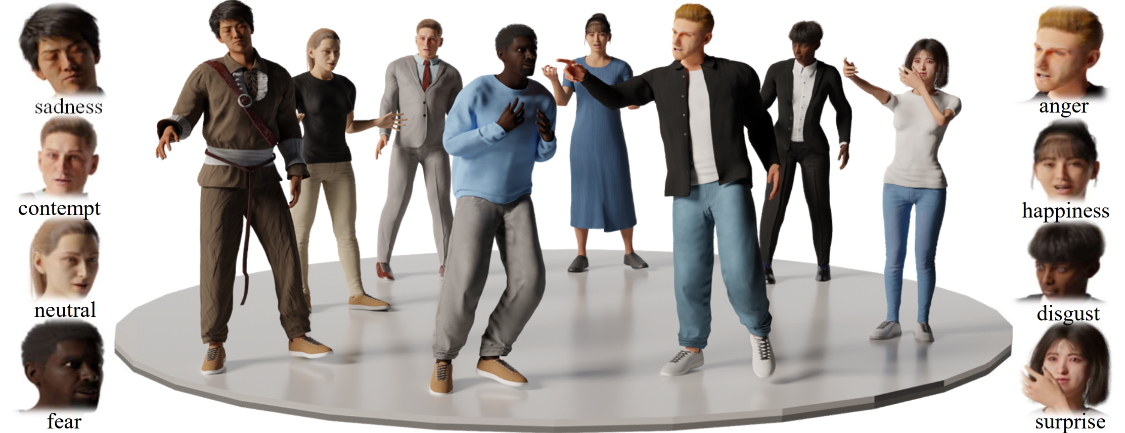
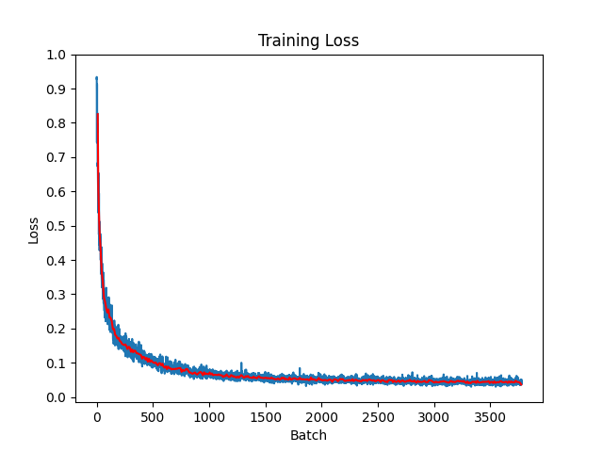
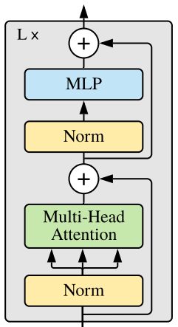
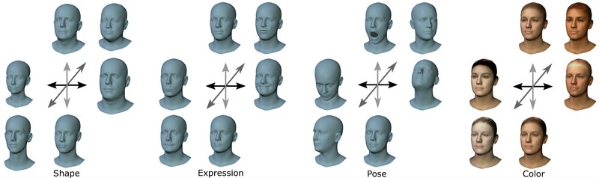
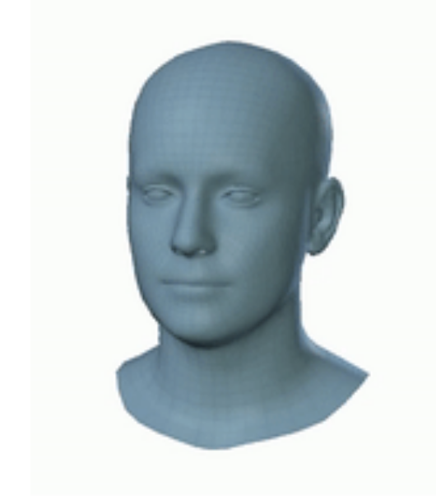
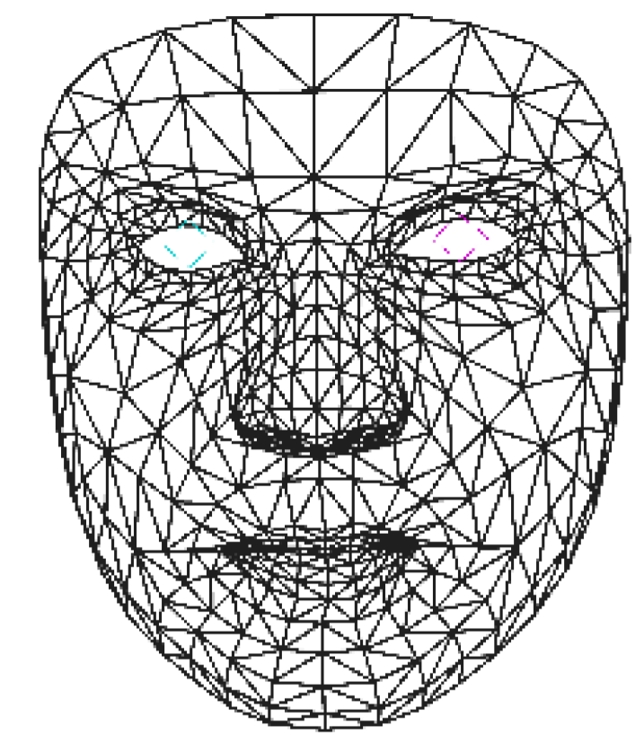
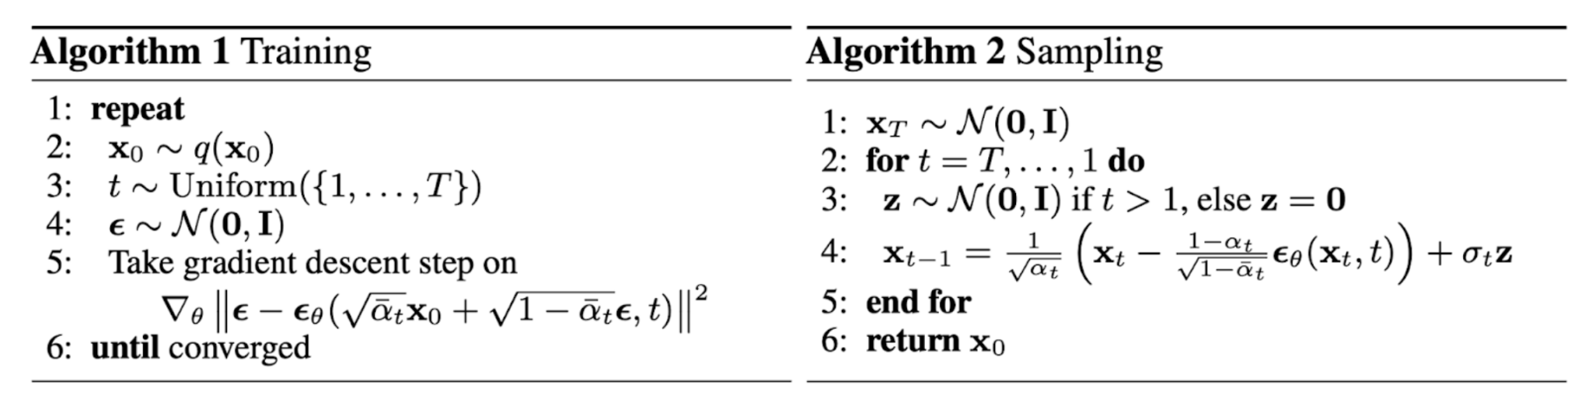
Taming Diffusion Models for Audio-Driven Talking Face
Team Members: Ava Cui, Ella Liu, Yanda Lu, Xinke Wang, Wentao Xie, Henry Yu, Zichang Zeng, Allen Zhang, Amie Zhang
Mentors: Dr. Xiaohu Guo, Steven Hogue, Ningna Wang
Motivation
Network Architecture
Results
Many existing audio-driven talking face models lack advanced training and research, resulting in poor synchronization between audio and facial movements.
Utilizing diffusion, our project generates a talking face model with facial movement matching the inputted audio.
+
Fig 1. Diffusion denoising process for image
Fig 14. Sequence of facial renders of talking face
Fig 2. Input audio and static face model generated with FLAME (see methods)
Diffusion
Diffusion: machine learning process where data is noised (fixed forward process) then denoised (reverse generative process)
Fig 9. Our full implemented network architecture, Positional Embedding is a learnable parameter
Fig 3. Training (forward step) algorithm 1 description
Training and Sampling
Fig 4. Full diffusion process (forward and reverse)
Fig 15. Results (Scan to visit our website, or go to bit.ly/g3talkingface)
Fig 16. Fully rendered model
Conclusion
Fig 5. Prediction (reverse step) algorithm 2 description
Testing on test data as well as our own recordings showed adequate ability to generate faux-realistic facial movements in accordance to the audio. Through the use of the BEAT 2.0.0 dataset, our model is trained on a diverse set of voices, allowing adaptability to potential accents and variations in vocal patterns in recordings presented to it.
We would like to thank our mentors Dr. Xiaohu Guo, Steven Hogue, and Ningna Wang for their guidance and encouragement throughout the camp. We would like to thank the University of Texas at Dallas and the CAST STEM Bridge camp for this wonderful opportunity.
Methods
Fig 10. BEAT 2, parameterized BEAT dataset into FLAME parameters; 80:20 split for training and testing
Fig 11. Graph of training loss over time
Sequential Training Method (Algorithm 1), where:
x₀: initial denoised sample
t: time step
ϵ, θ: network prediction
Sampling Denoising Method (Algorithm 2), where:
x_{T}: noisy input
~N: gaussian distribution
z: added noise to increase output diversity
Fig 7. Faces generated through FLAME parameters from the BEAT 2 dataset
References
Liu, Haiyang, et al. "EMAGE: Towards Unified Holistic Co-Speech Gesture Generation via Masked Audio Gesture Modeling." CVPR 2023.
Liu, Haiyang, et al. "Beat: A large-scale semantic and emotional multi-modal dataset for conversational gestures synthesis." ECCV 2022.
L. Zhu, X. Liu, X. Liu, R. Qian, Z. Liu, and L. Yu, ‘Taming Diffusion Models for Audio-Driven Co-Speech Gesture Generation’, in Proceedings of the IEEE/CVF Conference on Computer Vision and Pattern Recognition, 2023, pp. 10544–10553.
“Hubert,” huggingface.co. https://huggingface.co/docs/transformers/model_doc/hubert
Papers with Code. (n.d.). VOCASET dataset, https://paperswithcode.com/dataset/vocaset
‌
Fig 6. Transformer architecture
Fig 8. FLAME Model face template
Fig 9. 3D face model
Fig 12. Training process
Fig 13. Sampling process
Notes:
Transformers: base component for our denoising network, excel at sequence modelling with a normalization layer, MLP, a connected forward artificial neural network with at least 3 layers, Multi-Headed Attention, multiple heads that focus on different features of data Classifier-free Guidance: helps trade off between the diversity and sample quality during inference BEAT 2 Dataset: parameterized BEAT dataset–video captured data using 16 cameras to do motion capture–into the FLAME and SMPL-X parameters (pose θ, expression ψ, shape β). 30 people ~1600 audio files, ~1600 parameter files Caching: Data loading for Machine Learning uncompressed large datasets, making it more efficient to use, with pickle and lmdb Positional Encoding: learnable parameter for the network that provides a position when training
The transformer architecture the base component for denoising the network. The input data is normalized, then goes into the multi-head attention where the model can focus on different parts of the input simultaneously. After concatenating, the normalized data goes into the multilayer perceptron (MLP), where there are multiple linear layers with activation functions in between.
https://brand.utdallas.edu/graphics-visual-identity/color-palette/
https://drive.google.com/file/d/16ZH8izFN08Q6Ali--EzOrPO6Dwv_CAtp/view?usp=sharing
https://spotify.link/AusWAUbt1Kb

Slide 2
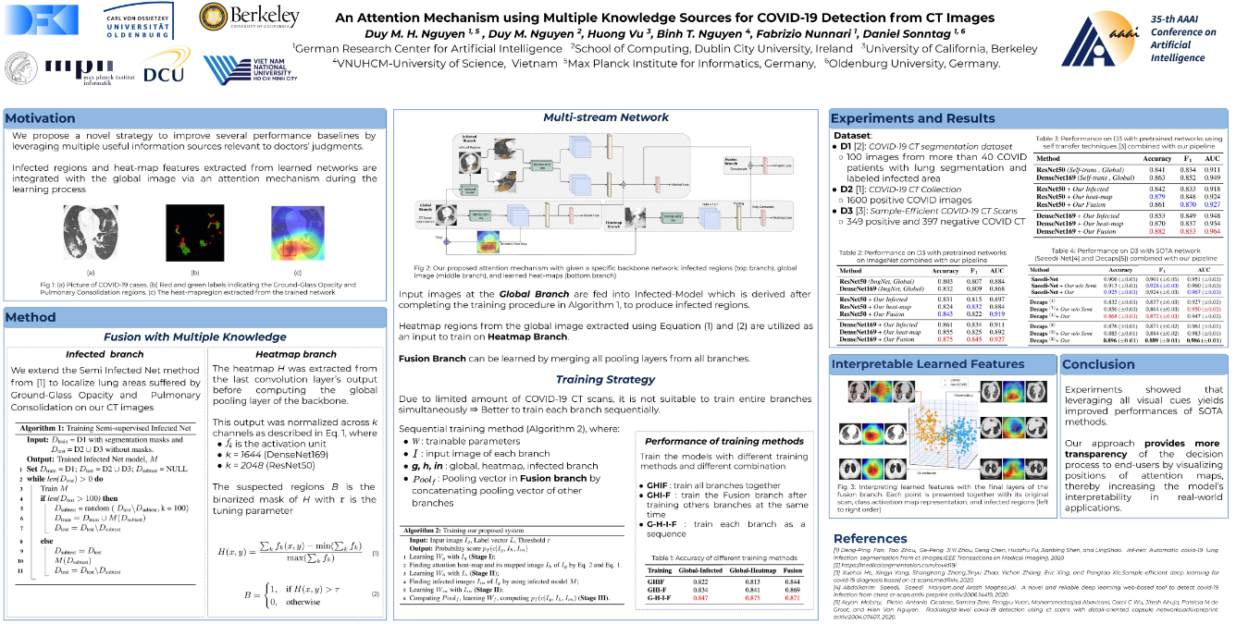

Slide 3
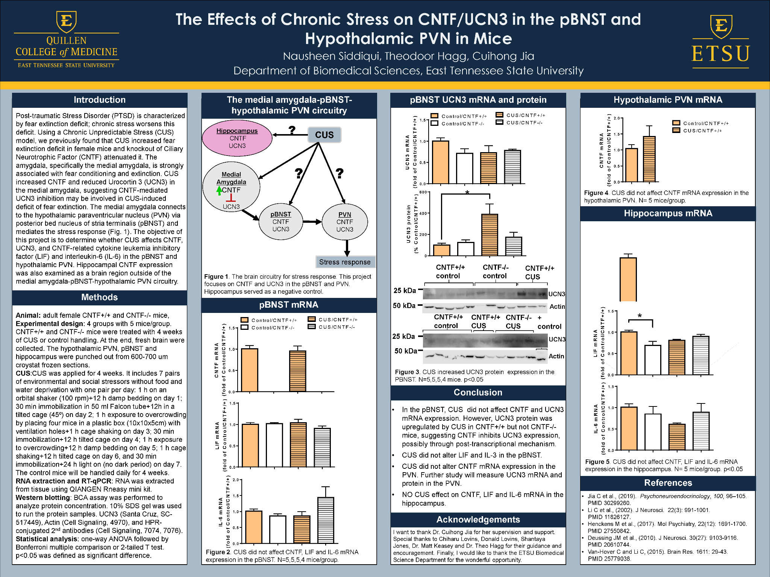

Slide 4
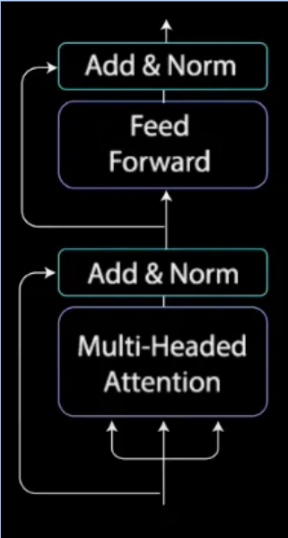
Add & Norm
Feed Forward
Add & Norm
Multi-Headed Attention

Slide 5
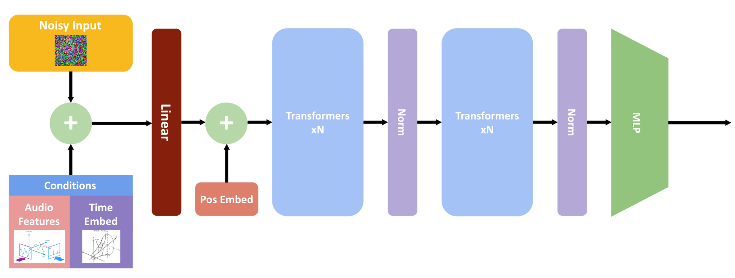
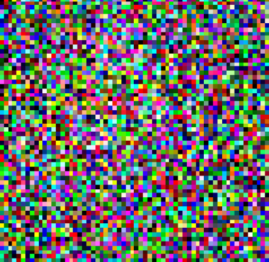
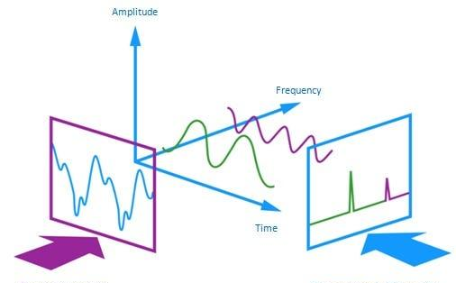
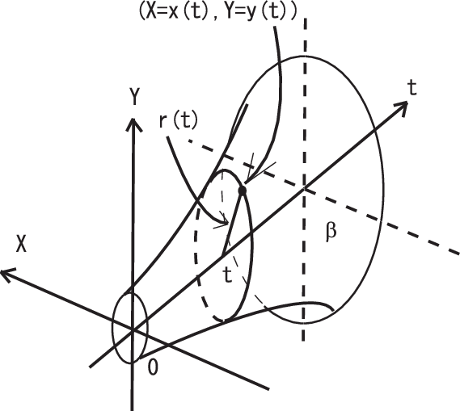
Audio Input
HuBERT Encoder
(Transformers
xN)
Transformers
xN
+
+
MLP
Convolutional Neural Networks (CNN)
Norm
Norm
Conditions
Pos Embed
Audio
Features
Time Embed
TE(time,2i)​=sin(time​/10000^2i/d)
TE(time,2i)​=cos(time​/10000^2i/d)

Slide 6
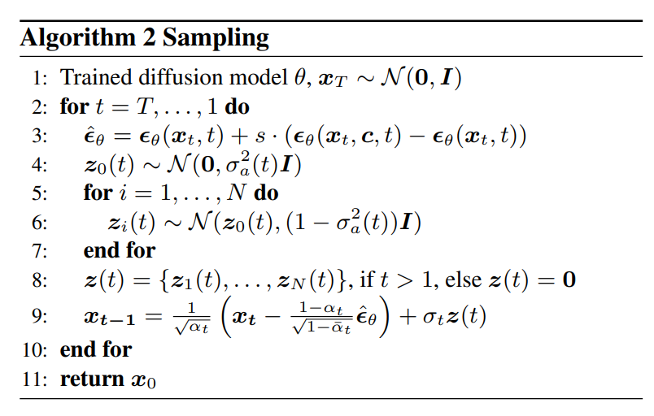

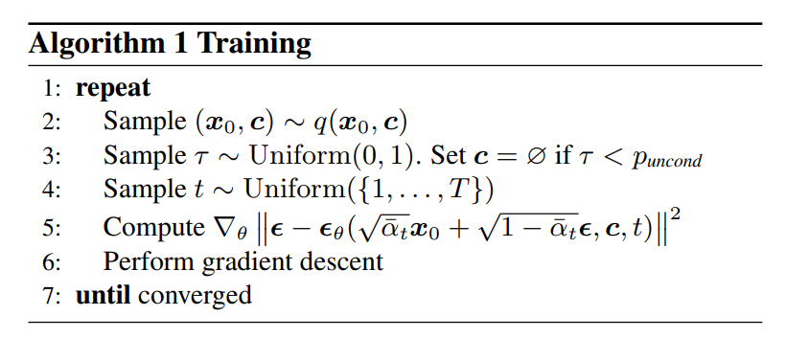
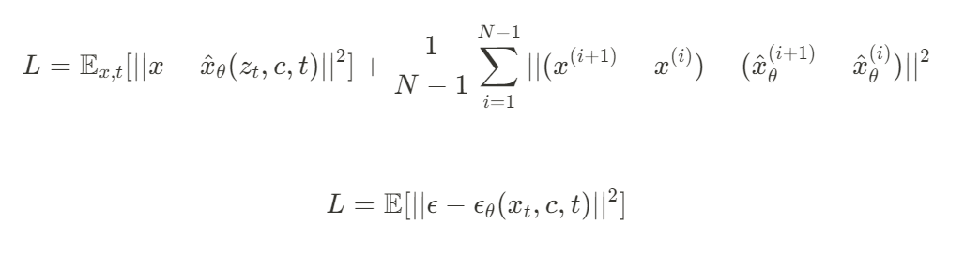
Taming Diffusion Models For Audio-Driven Talking Face Gestures
Team Members: Ava Cui, Ella Liu, Yanda Lu, Xinke Wang, Wentao Xie, Henry Yu, Zichang Zeng, Allen Zhang, Amie Zhang
Mentors: Dr. Xiaohu Guo, Steven Hogue, Ningna Wang
Motivation
Network Architecture
Results
Many existing audio-driven talking face models lack advanced training and research, resulting in poor synchronization between audio and facial movements.
Utilizing diffusion, our project generates a talking face model with facial structure movement matching the inputted audio.
+
Fig 1. Diffusion denoising process for image
Fig 2. Input audio and static face model generated with FLAME (see methods)
Fig 11. Sequence of facial renders of talking face
Sampling Method:
x_{T} noisy input
classifier free guidance
Diffusion
Diffusion: machine learning process where data is noised (fixed forward process) then denoised (reverse generative process)
Forward Process
Fig 6. Our full implemented network architecture, Positional Embedding is a learnable parameter
Fig 12. Sampling process
Training Strategy
Conclusion
Dataset Overview:
BEAT2 Dataset: Contains multi-language, large-scale emotional and semantic datasets that are conversationally accurate, featuring facial and gestural expressions.
Data Split: 80% training and 20% testing. This split ensures a high number of training data without risking overfitting or compromising model accuracy.
Methods for Training:
Transformers: base component for our denoising network, excel at sequence modelling with a normalization layer
Classifier-free Guidance: balances between diversity and sample quality during inference
Caching: Data loading for Machine Learning uncompressed large datasets, making it more efficient to use, with pickle and LMDB
Results showed that the model was able to successfully train an advanced talking face model using the audio we inputted and BEAT datasets. [finish when obtained more data on results]
Our approach achieves a more adaptable talking face model (examples of adaptability)
Reverse Process
Methods
FLAME (Faces Learned with an Articulated Model and Expression):
Pose is represented by the eyes, neck, and jaw.
Meshes (M):
set of vertices (V) where each vertex (v ∈ V)is defined as [x, y, z] coordinates
set of faces (F) defines surface of mesh
Skinning:
With the mesh function M(β,θ,Ψ)=W(T_{P}​(β,θ,Ψ),J(β),θ,W) it attaches the mesh to a skeleton
β: Shape parameters.
θ: Pose parameters.
Ψ: Expression parameters.
T_{P​}: Template mesh.
J: Joint locations as a function of shape parameters.
W: Skinning weights.
Acknowledgment
Fig 8. Graph of training loss over time
Training method:
x₀: initial sample
t: time step
~N: gaussian distribution
ϵ, θ: network prediction
We want to thank our mentors Dr. Xiaohu Guo, Steven Hogue, and Ningna Wang for their guidance and encouragement throughout the camp. We would like to thank University of Texas at Dallas and the CAST STEM Bridge camp for this wonderful opportunity.
Fig 3. FLAME Model face template
Fig 4. 3D face model defined as mesh
Transformers: base component for our denoising network, excel at sequence modelling with a normalization layer, MLP, a connected forward artificial neural network with at least 3 layers, Multi-Headed Attention, multiple heads that focus on different features of data
References
Fig 7. Large-scale BEAT2 expression and gestural dataset
Liu, Haiyang, et al. "EMAGE: Towards Unified Holistic Co-Speech Gesture Generation via Masked Audio Gesture Modeling." CVPR 2023.
Liu, Haiyang, et al. "Beat: A large-scale semantic and emotional multi-modal dataset for conversational gestures synthesis." ECCV 2022.
L. Zhu, X. Liu, X. Liu, R. Qian, Z. Liu, and L. Yu, ‘Taming Diffusion Models for Audio-Driven Co-Speech Gesture Generation’, in Proceedings of the IEEE/CVF Conference on Computer Vision and Pattern Recognition, 2023, pp. 10544–10553.
[1]“Hubert,” huggingface.co. https://huggingface.co/docs/transformers/model_doc/hubert (accessed Jul. 06, 2024).
https://paperswithcode.com/dataset/vocaset
‌
Fig 5. Transformer architecture
Fig 9. Training process
Fig 10. Loss function equations (MSE)
Notes:
Transformers: base component for our denoising network, excel at sequence modelling with a normalization layer, MLP, a connected forward artificial neural network with at least 3 layers, Multi-Headed Attention, multiple heads that focus on different features of data Classifier-free Guidance: helps trade off between the diversity and sample quality during inference BEAT 2 Dataset: parameterized BEAT dataset–video captured data using 16 cameras to do motion capture–into the FLAME and SMPL-X parameters (pose θ, expression ψ, shape β). 30 people ~1600 audio files, ~1600 parameter files Caching: Data loading for Machine Learning uncompressed large datasets, making it more efficient to use, with pickle and lmdb Positional Encoding: learnable parameter for the network that provides a position when training
The transformer architecture the base component for denoising the network. The input data is normalized, then goes into the multi-head attention where the model can focus on different parts of the input simultaneously. After concatenating, the normalized data goes into the multilayer perceptron (MLP), where there are multiple linear layers with activation functions in between.
https://brand.utdallas.edu/graphics-visual-identity/color-palette/
https://drive.google.com/file/d/16ZH8izFN08Q6Ali--EzOrPO6Dwv_CAtp/view?usp=sharing
https://spotify.link/AusWAUbt1Kb

